Slide 1
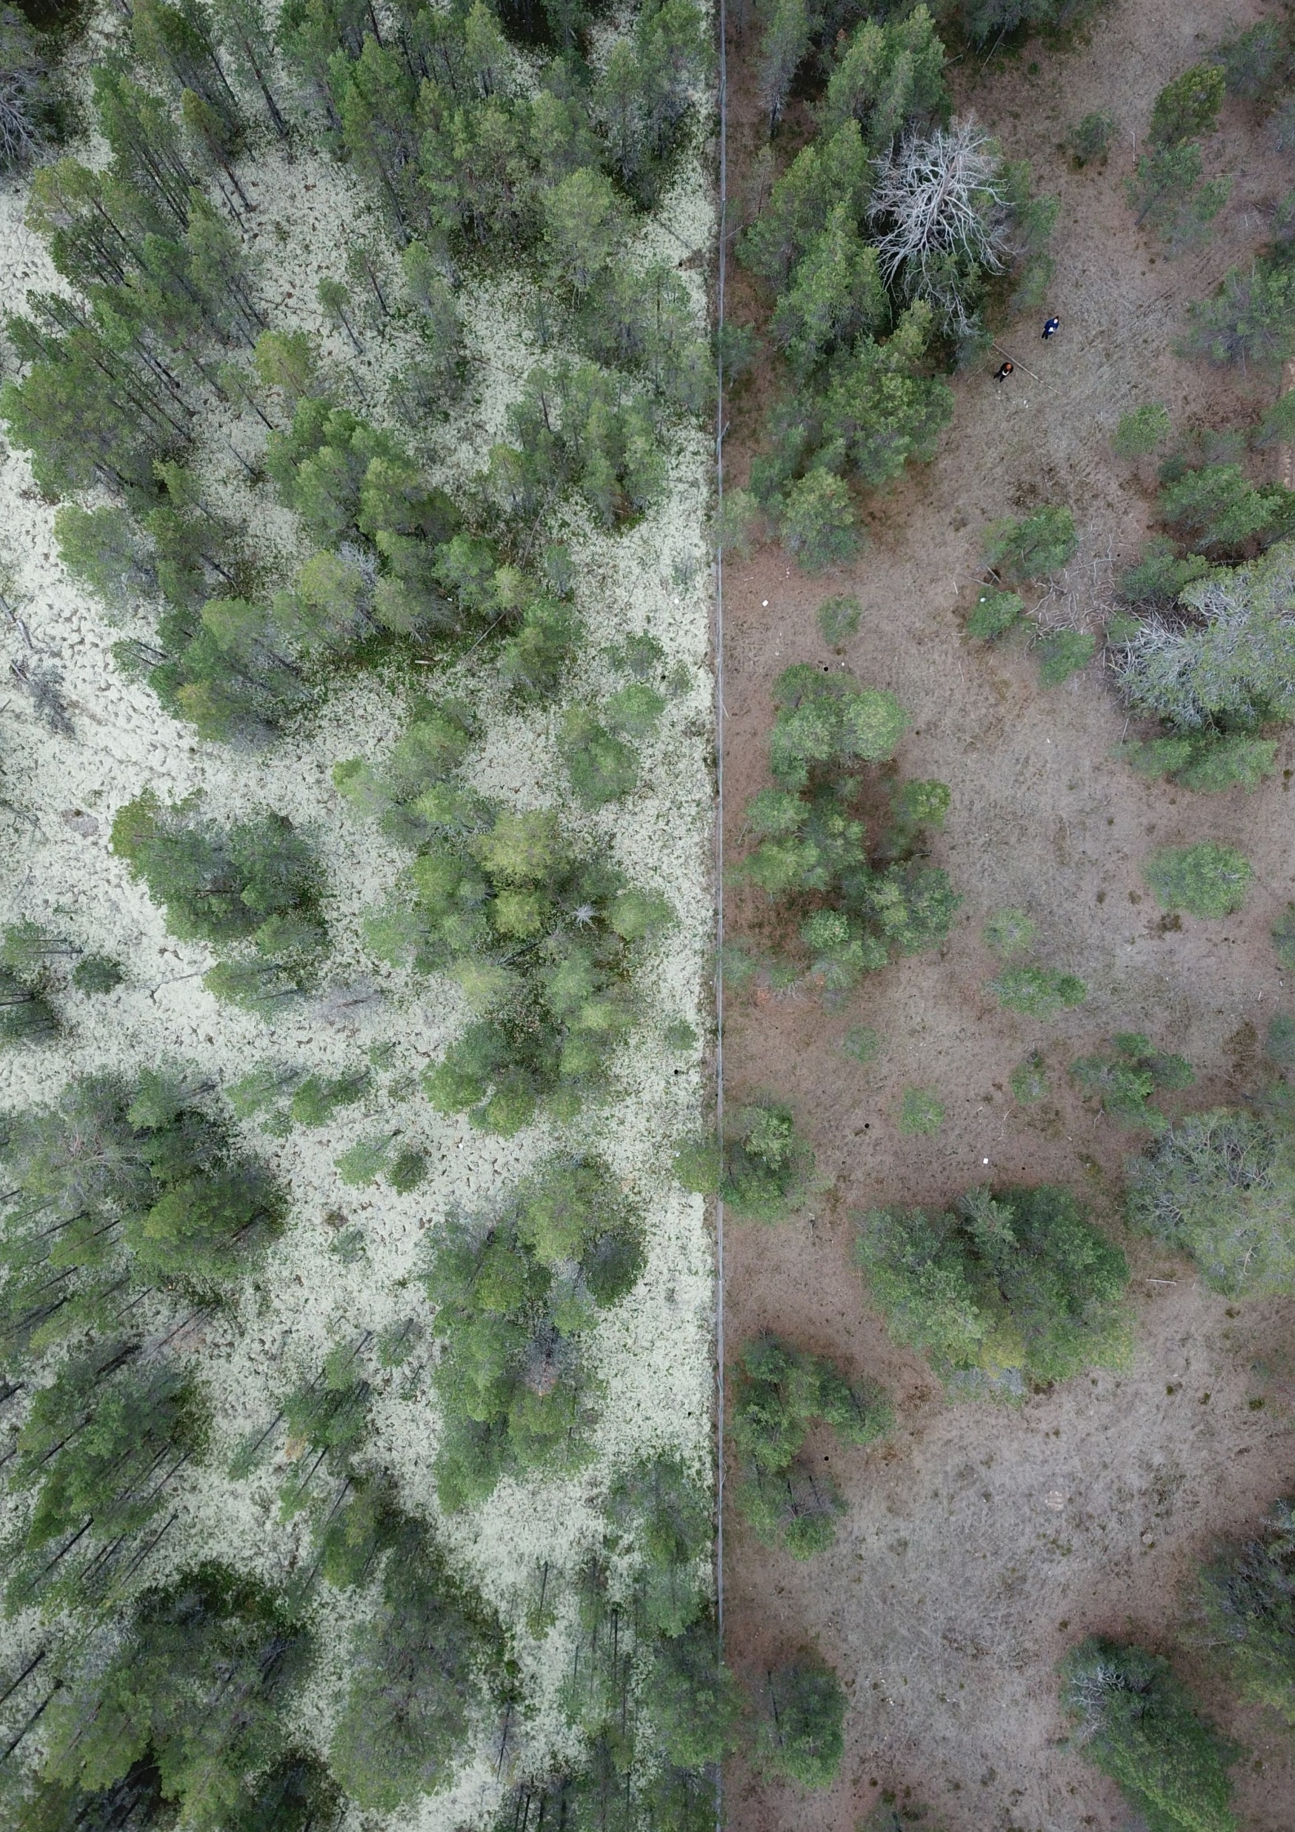
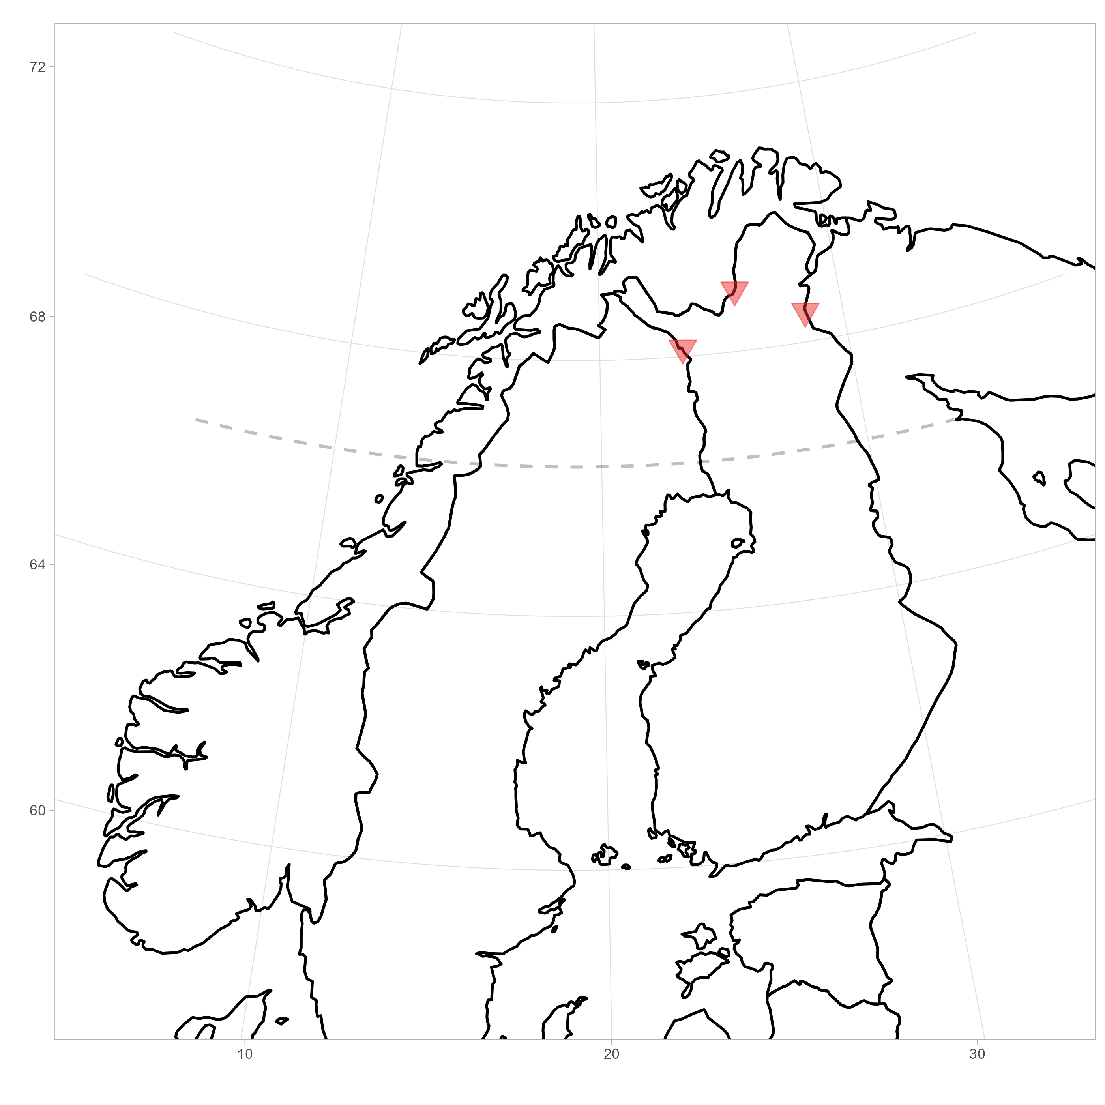
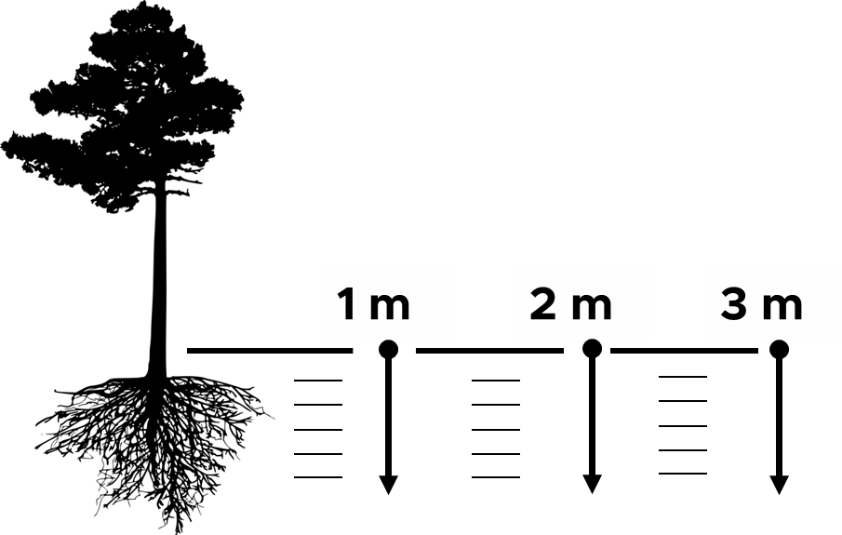
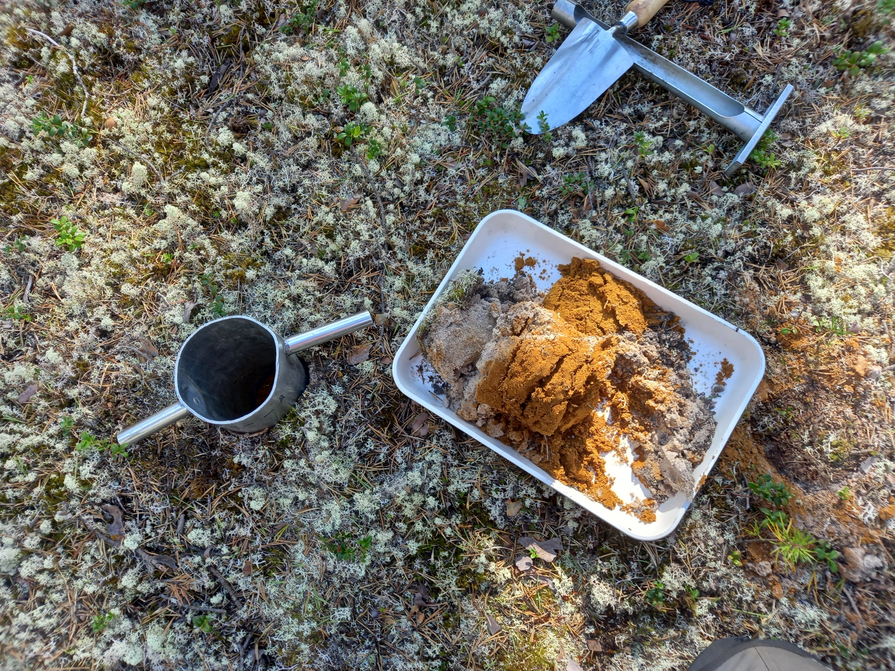
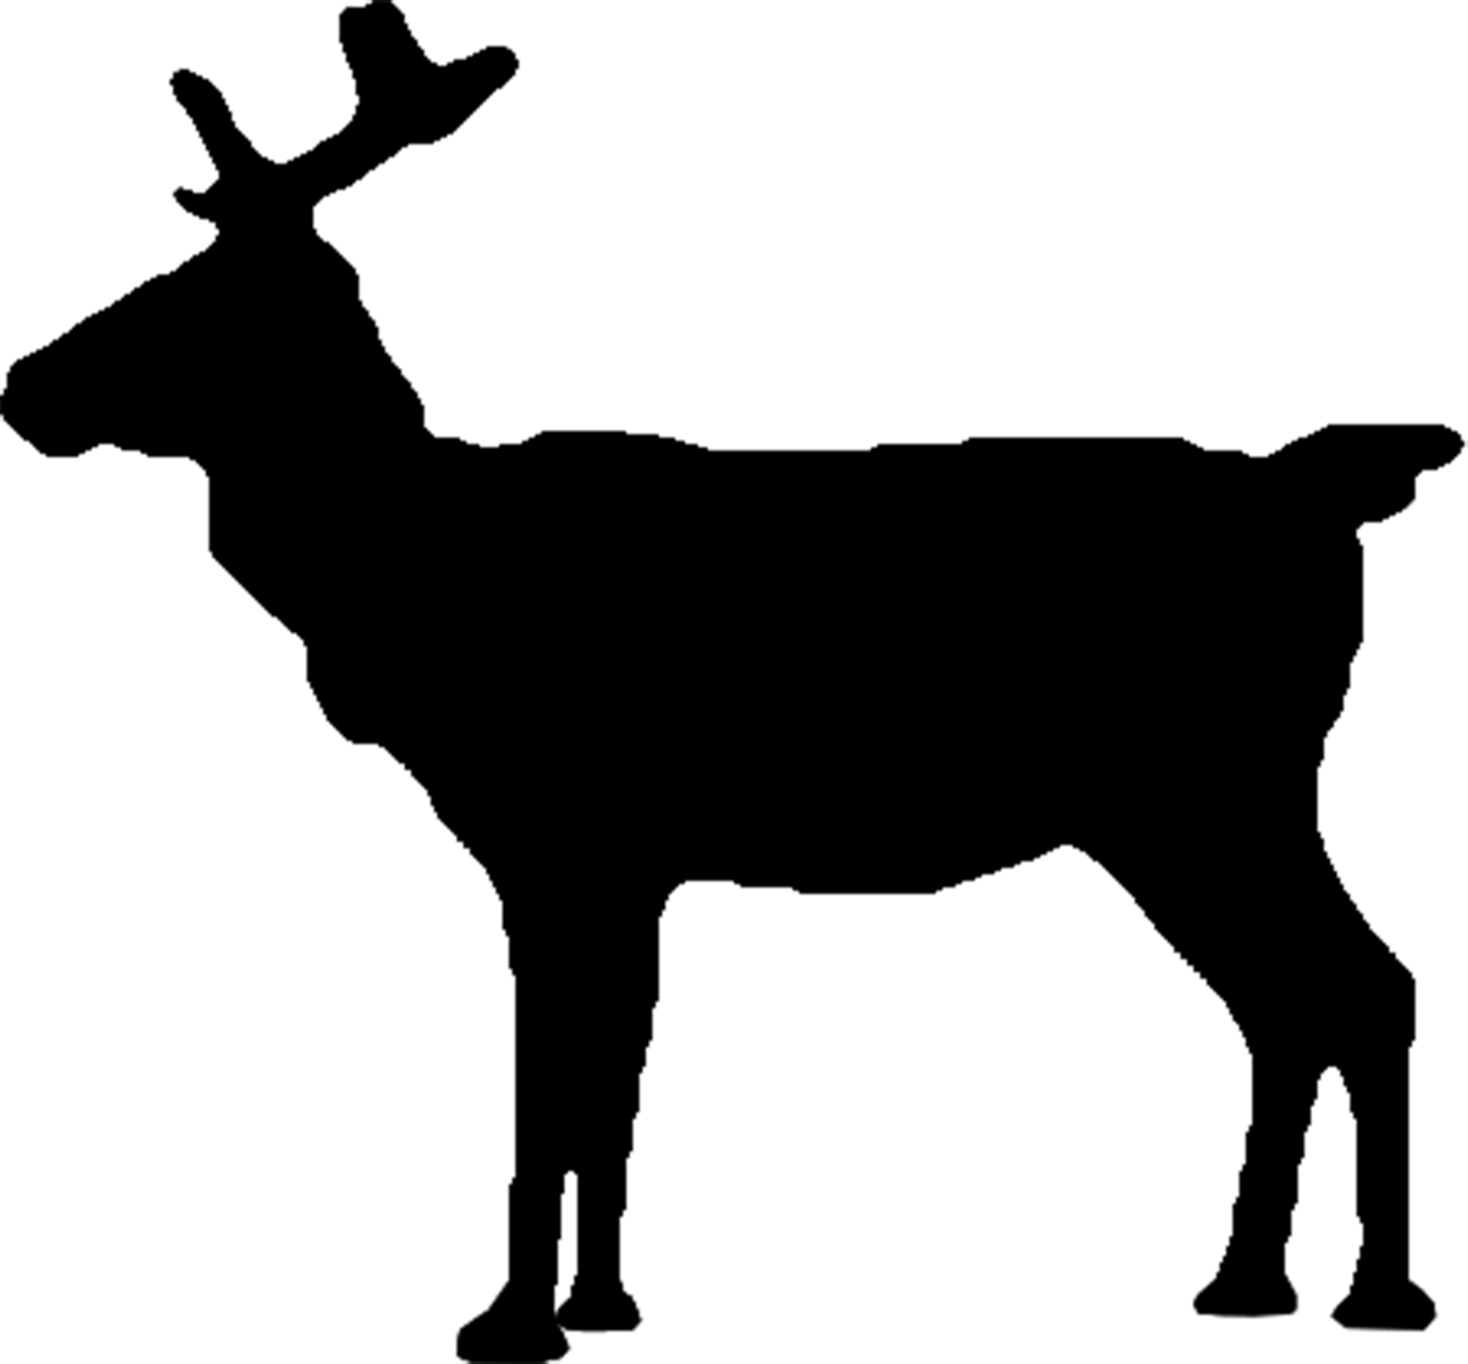


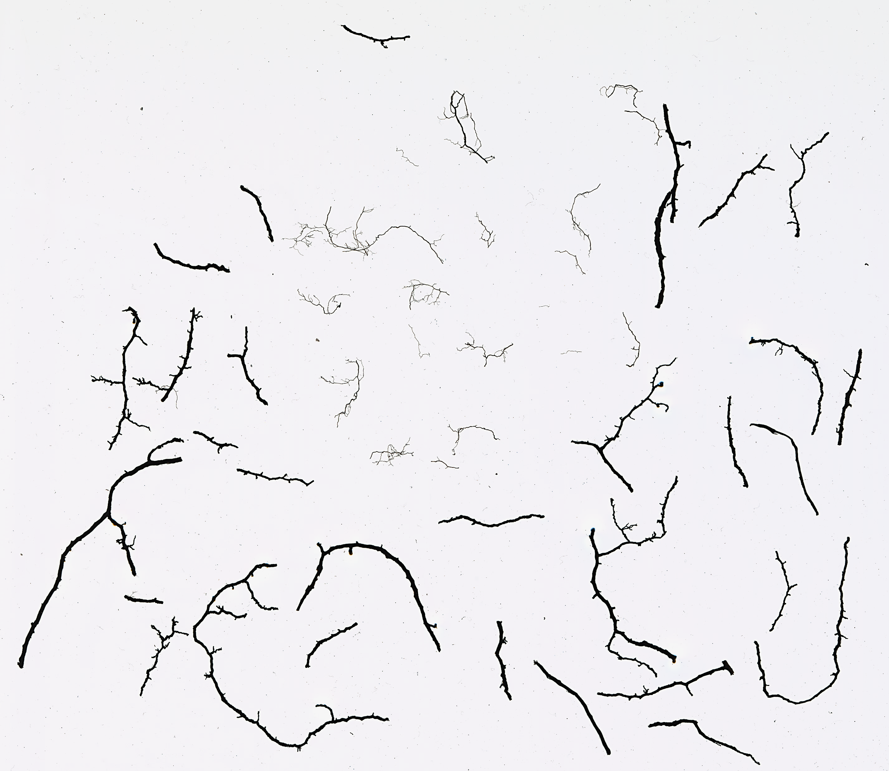
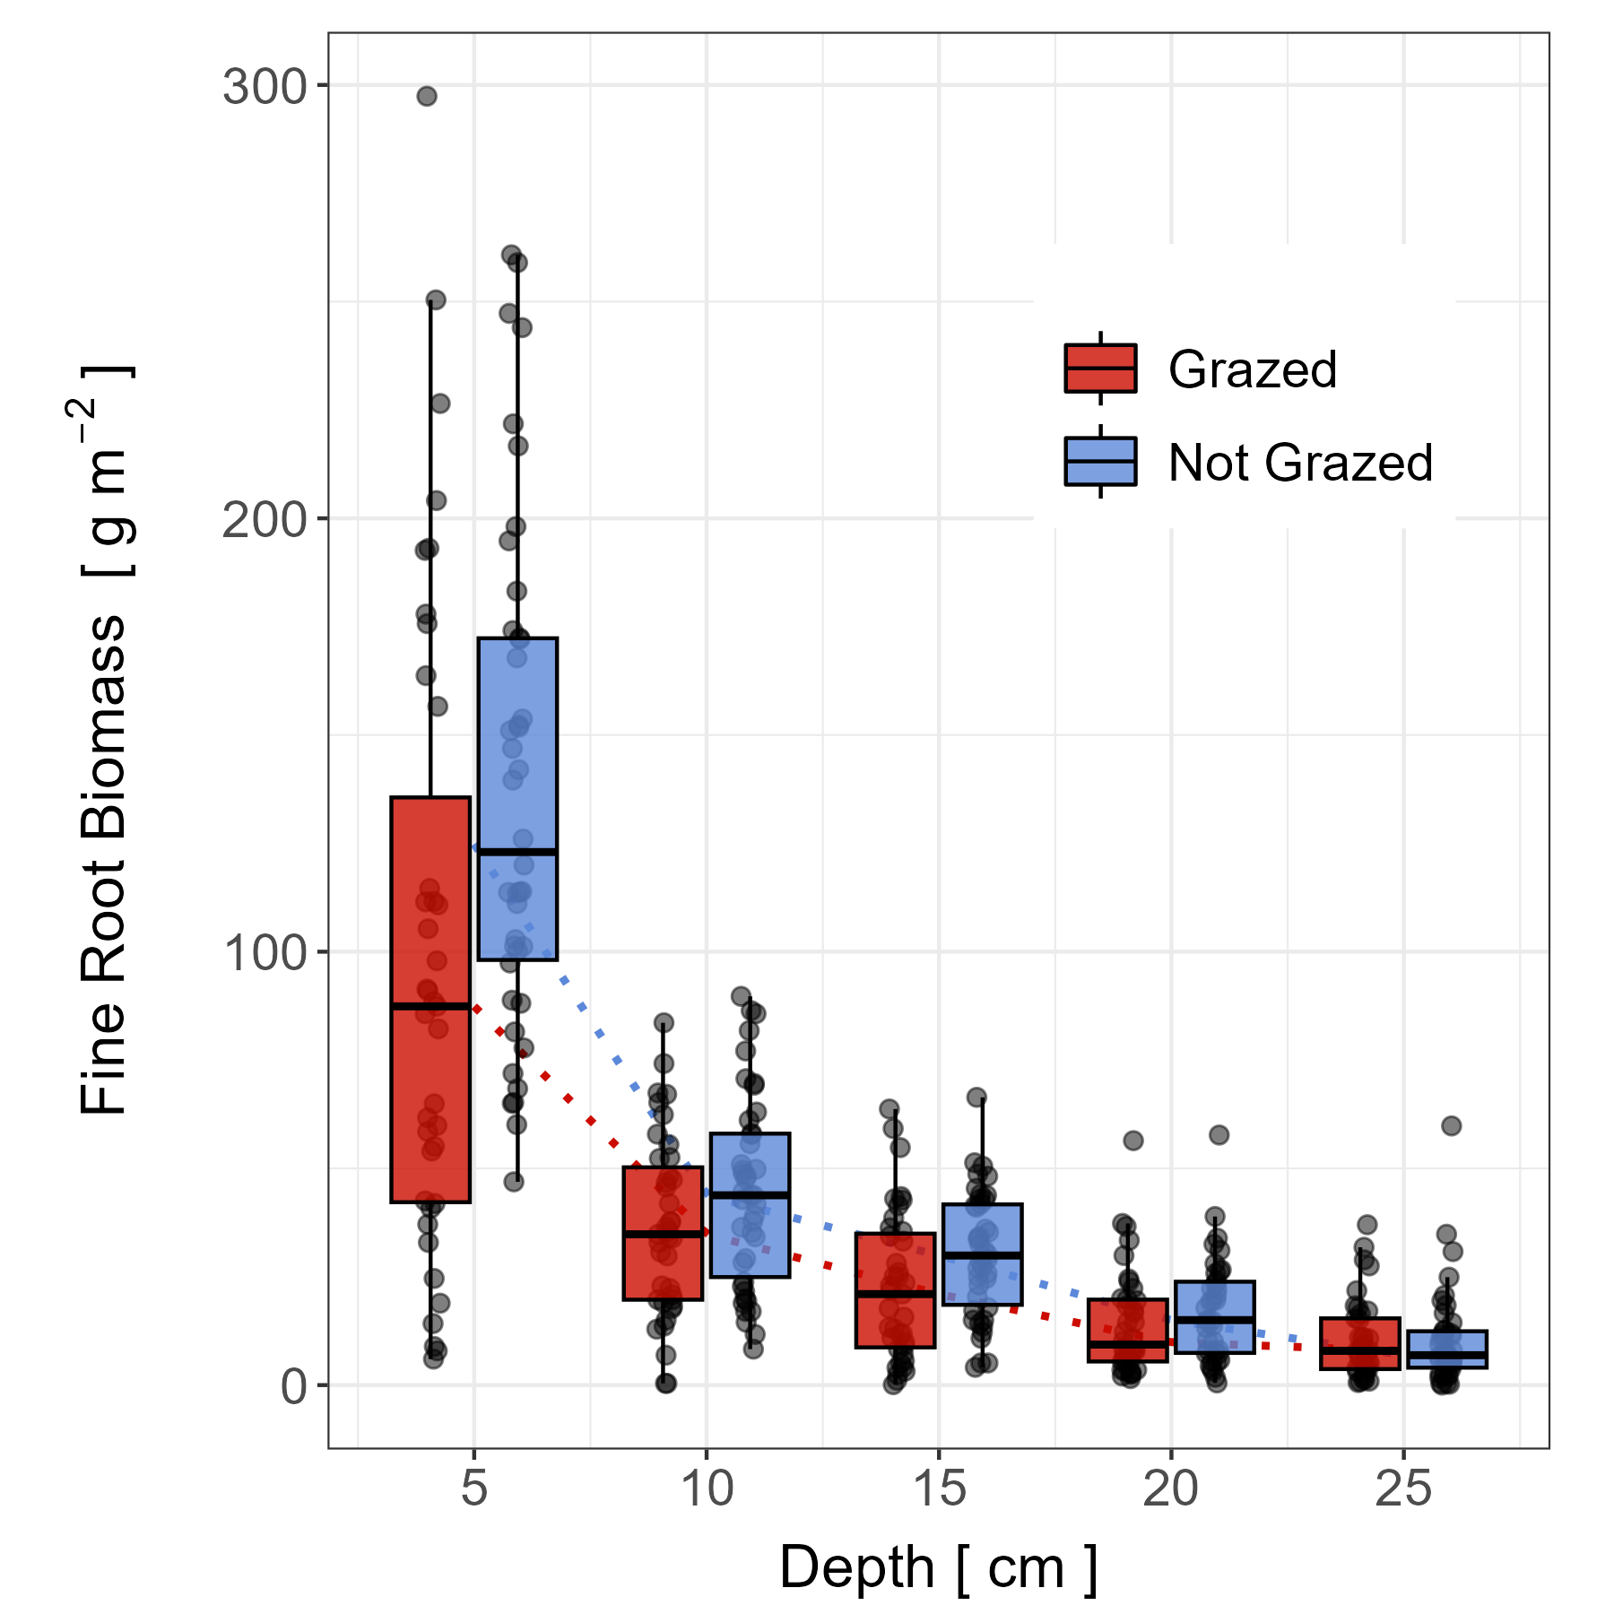
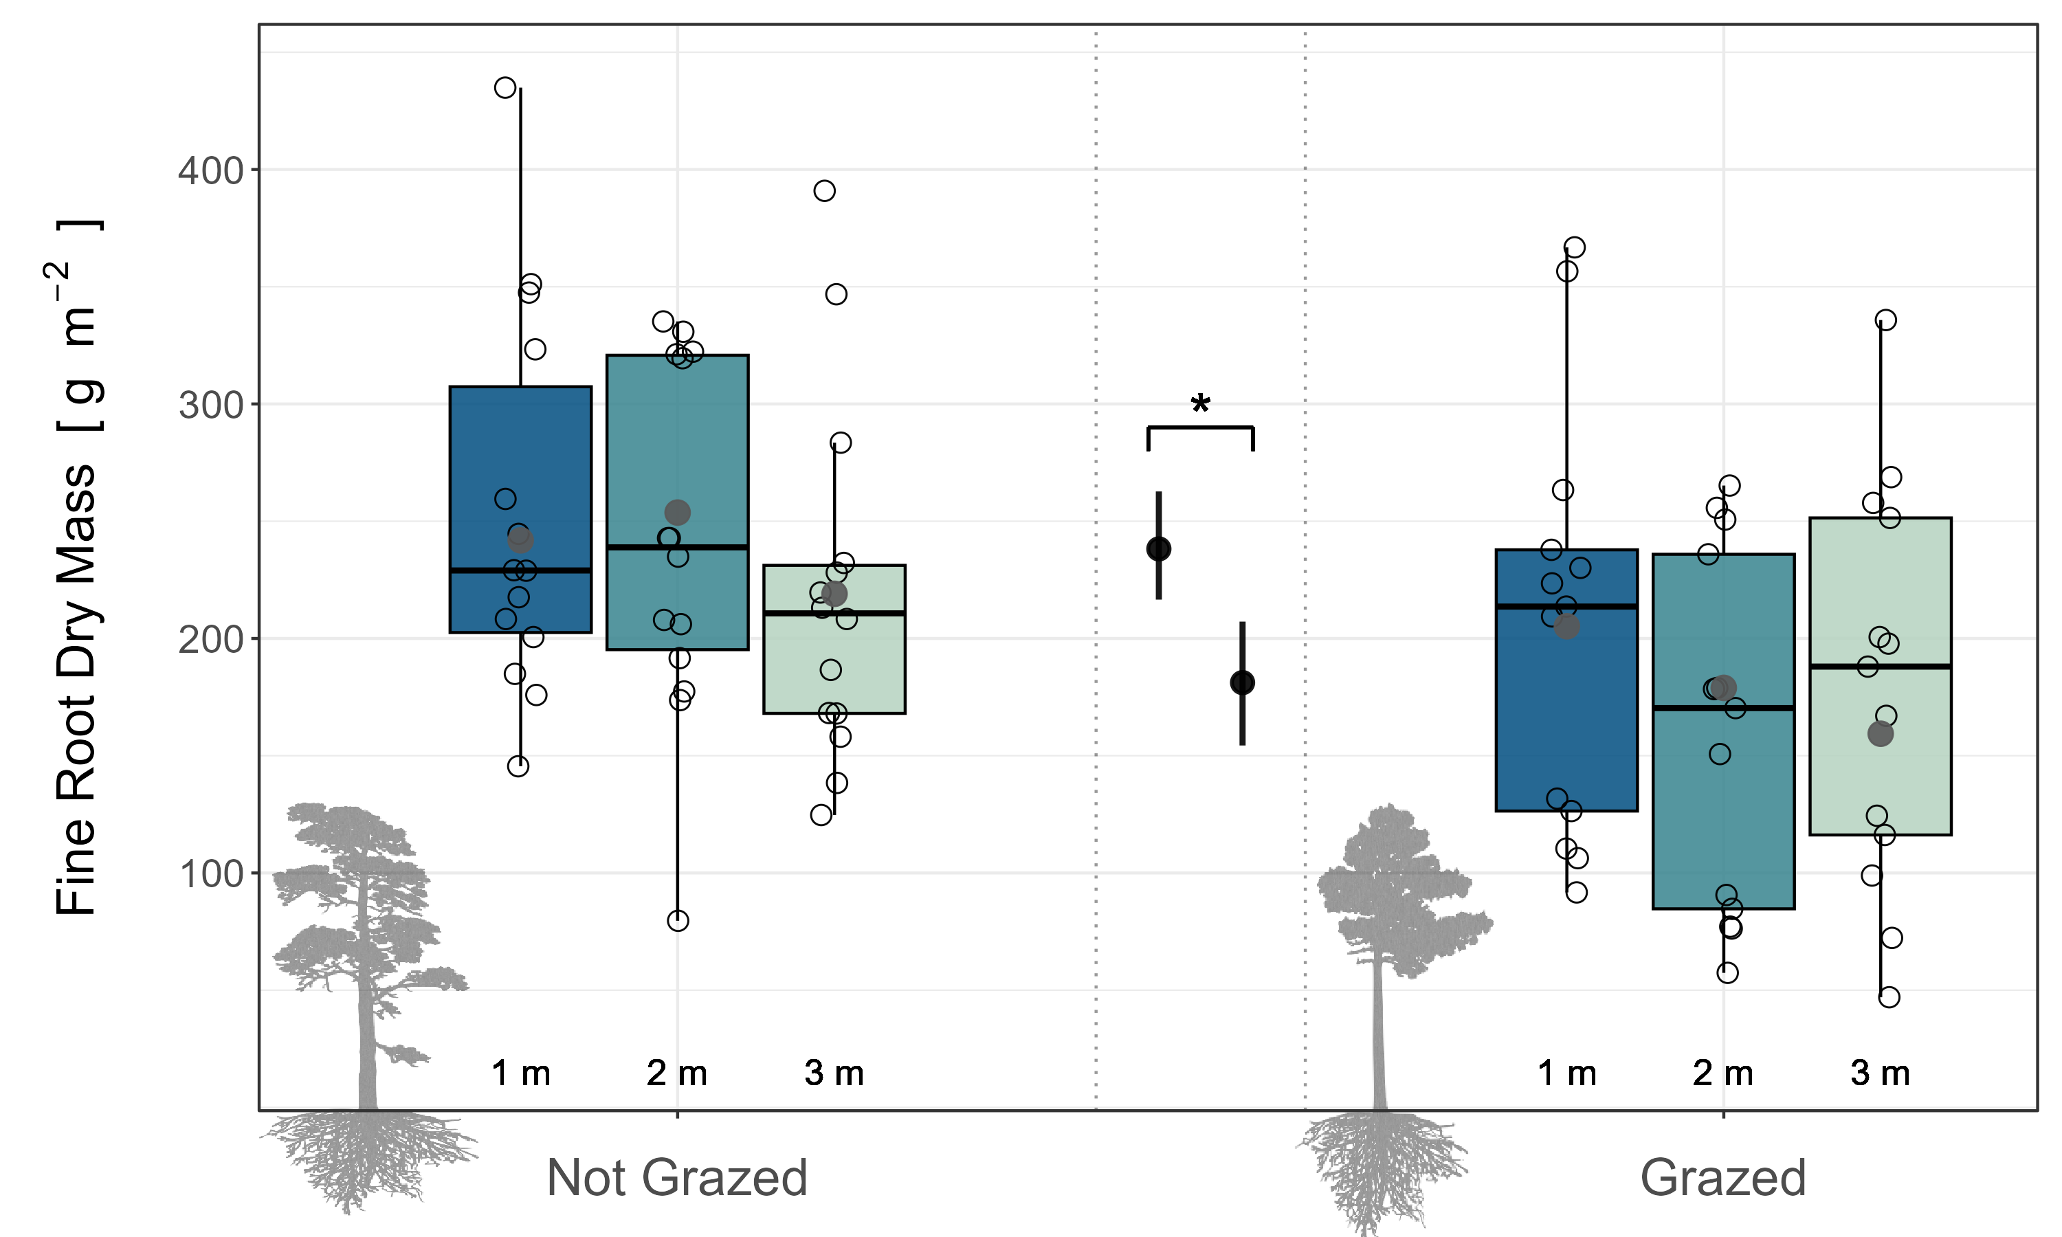
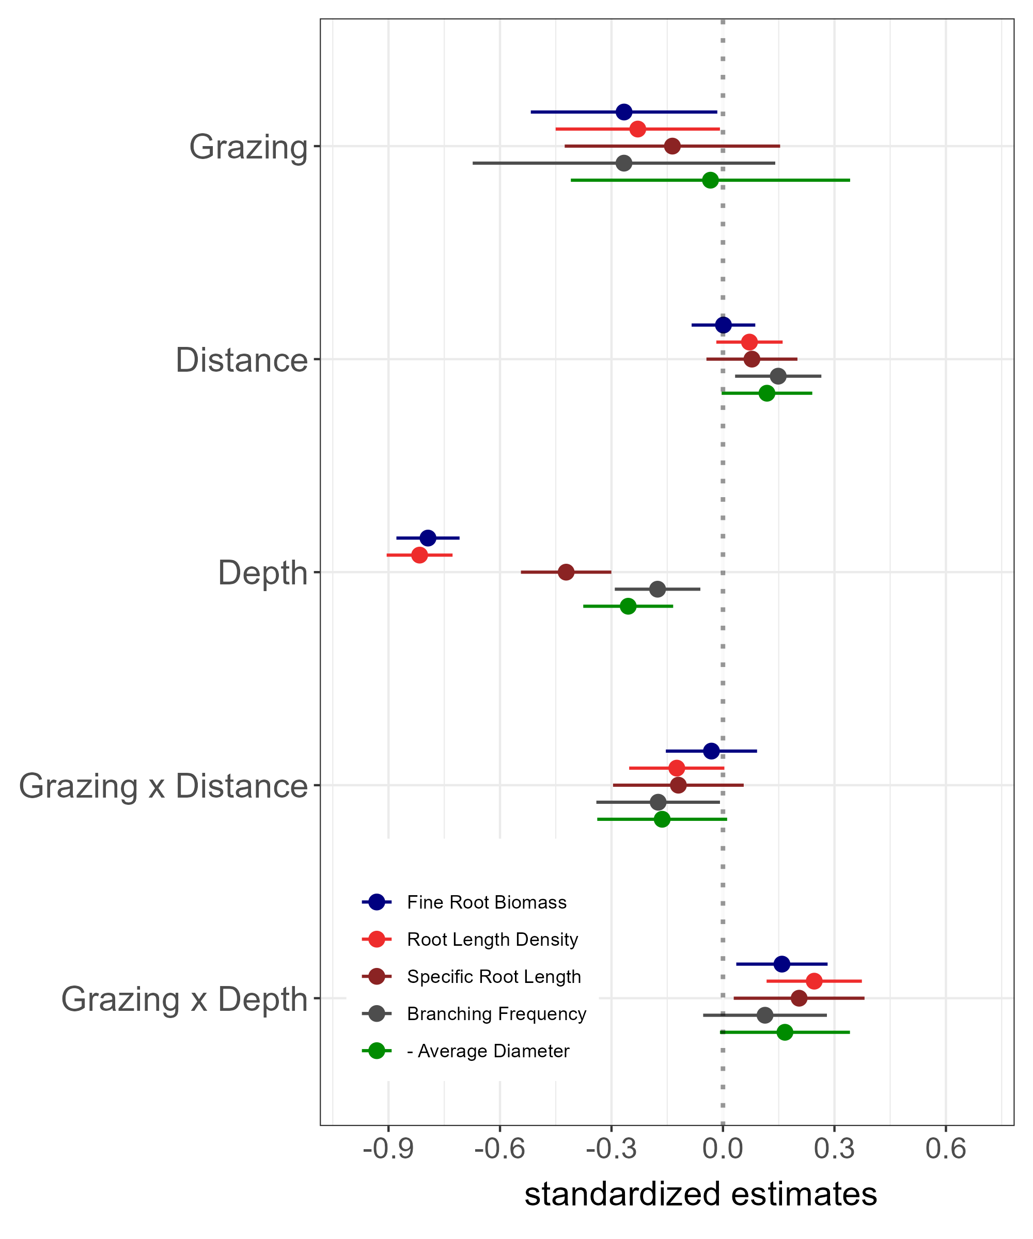



Reindeer reduce topsoil roots and explorative community root traits
Horizontal and vertical root distribution in oligotrophic northern pine forests
Johannes Cunow, Femke Pijcke, Johan Olofsson, and Gesche Blume-Werry
Umeå University, Department of Ecology and Environmental Science
Background
Reindeer:
remove lichen
trample in the open
extremify soil temperature
dry the soil
Does Grazing …?
Study Site
Method
Reduce root biomass
Impact topsoil roots most
Change root traits
Interact with tree distance
>50 years ungrazed
5
10
15
20
25 cm
Root Traits
Results
Depth Shift
28 % topsoil root reduction (39g)
Distance Homogeneity
24 % less fine roots (57g)
Trait Coherency & Distance?!
Heavy reindeer grazing forces fine roots in deeper soil homogeneously across tree distance and the reduction is strongest in the topsoil. Similarly, explorative root community traits follow mass the distribution patterns, but additionally, distance and the interaction of grazing and distance have a weak effect. Overall, community root traits suggest vulnerability of ericaceous shrubs to reindeer grazing belowground, potentially more so in the open.
Johannes Cunow

